Slide 1
Cyclistic Bike-Share Case Study
How annual members and casual riders use the service differently
Data Analysis of Q1 2019 & Q1 2020 Trip Data
Juan Diego
12/30/2025

Slide 2
Agenda
Business Task & Stakeholders
Data Sources
Data Processing & Cleaning
Key Findings – Overview
Visualizations
Key Insights Summary
Top 3 Recommendations
Next Steps & Additional Data
Conclusion

Slide 3

Business Task & Stakeholders

Slide 4

Business Task ​
Analyze historical bike trip data to understand key differences in usage between casual riders and annual members
Goal: Inform targeted marketing strategies to convert casual riders into annual members for future growth

Slide 5
Key Stakeholders
Lily Moreno – Director of Marketing (campaigns & initiatives)
Cyclistic Marketing Analytics Team – Data-driven strategy
Cyclistic Executive Team – Approves marketing programs

Slide 6
Data Sources
Public Divvy trip data (basis for fictional Cyclistic)
Q1 2019: Divvy_Trips_2019_Q1.csv
Q1 2020: Divvy_Trips_2020_Q1.csv
~700,000 cleaned trips after removing invalid records
Data Credibility (ROCCC)
Reliable, Original, Comprehensive, Cited
Licensed under Divvy Data License Agreement
Privacy-protected (no personal information)

Slide 7
Data Processing & Cleaning
Tools Used
Google Sheets – Initial cleaning & calculated fields
RStudio (tidyverse, lubridate) – Reproducible cleaning & combining datasets
Key Cleaning Steps
Standardized column names & user types (Subscriber → member, Customer → casual)
Calculated ride_length (minutes) and day_of_week
Removed invalid rides (<1 min, >24 hours, missing data)
Added variables: start hour, date, month

Slide 8
Key Findings Overview
Major Differences in Usage
Annual members: More frequent, shorter rides, weekday & rush-hour focused → Commuting behavior
Casual riders: Less frequent, much longer rides, weekend & afternoon focused → Leisure/recreational behavior
Ride Volume
Members: ~75–80% of rides in 2019, ~65–70% in 2020 (casual increase during early COVID)
Ride Duration
Casual: ~35–45 minutes average
Members: ~12–15 minutes average

Slide 9
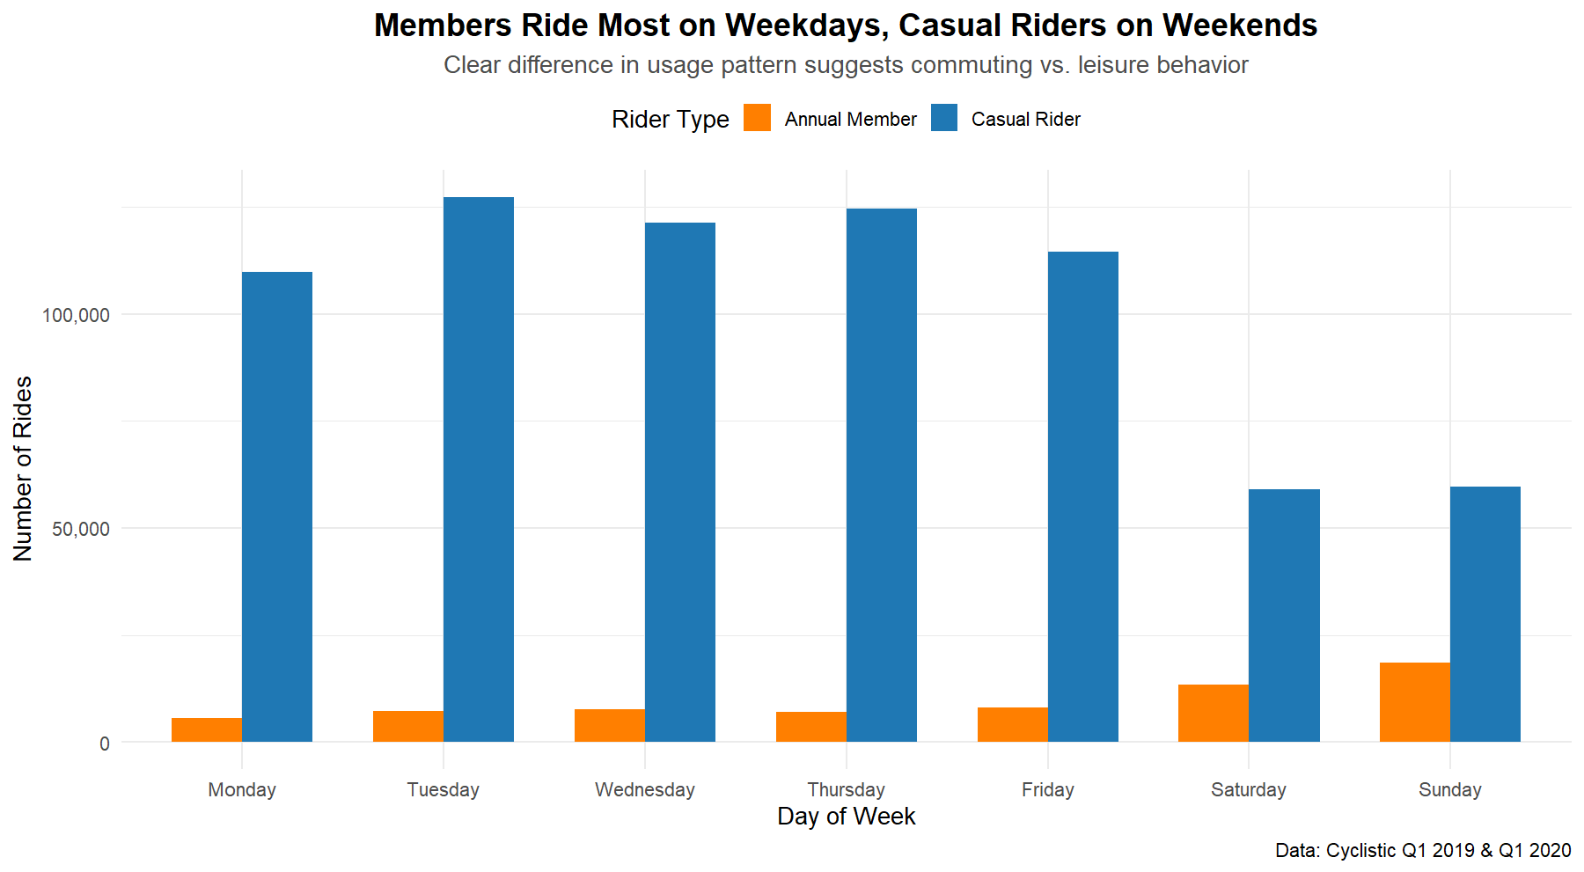

Slide 10
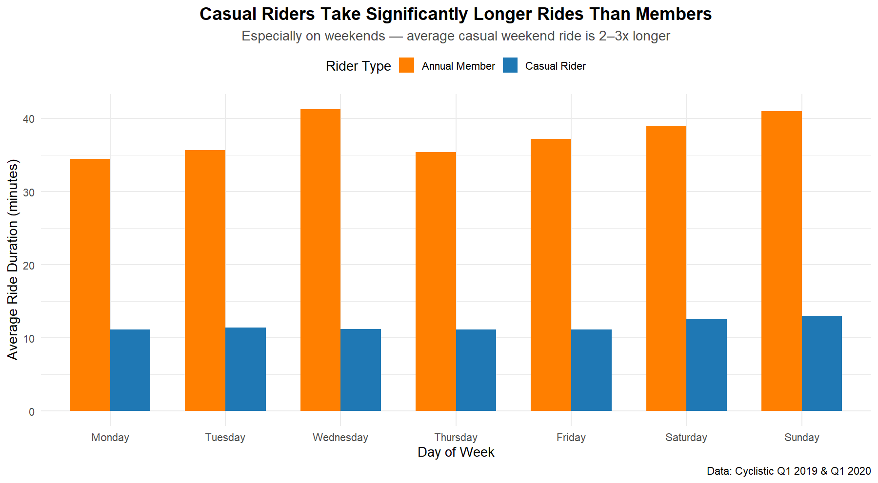

Slide 11
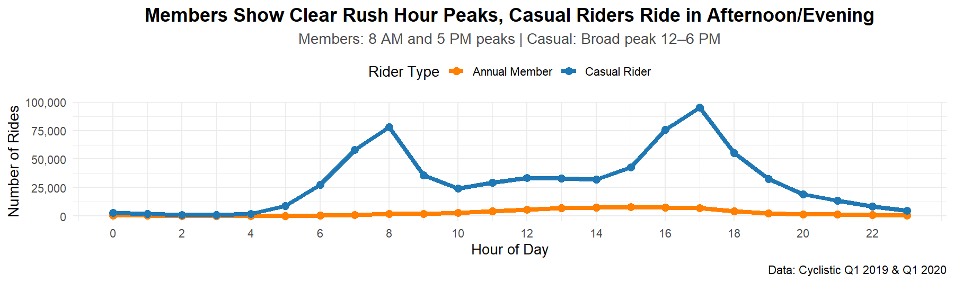

Slide 12
Key Insights Summary
How Users Differ
Annual members: Routine daily transportation (frequent, short, weekday commutes)
Casual riders: Occasional longer trips (weekends, afternoons, leisure/exploration)
Year-over-Year Shift
Notable increase in casual rider activity in Q1 2020 (early COVID influence)

Slide 13
Top 3 Recommendations ​
1. "Weekend Rider" Campaign
Target casual riders with promotions highlighting cost savings on longer weekend rides
Use social media & geo-targeted ads near popular routes
2. "Unlimited Convenience" Messaging
Emphasize membership savings for rides >30 minutes or frequent use
Include cost calculator showing break-even points
3. Spring Conversion Offer
Personalized discount or 30-day trial for casual riders
Timed for high-usage seasons to lower conversion barrier

Slide 14
Next Steps & Additional Data
Develop & A/B test targeted digital campaigns
Measure conversion rates and ROI
Suggested Additional Data
Full 12-month dataset (e.g., 2023–2024) for seasonal trends
Weather data, pricing experiments, or customer surveys

Slide 15
Conclusion
Clear behavioral differences provide actionable insights
Targeted marketing focused on casual riders' longer/weekend rides can drive annual membership growth
Thank You
Questions?

